Slide 1
Calories Prediction using Machine Learning
Presented by:
B. Baranitharan, B.Tech AI&DS-lll (Naanmudhalvan ID:au821721243011)
Sir Issac Newton College Of Engineering & Technology

Slide 2
AGENDA
PROJECT STATEMENT
PROJECT OVERVIEW
SYSTEM DEVELOPMENT APPROACH
ALGORITHM & DEPLOYMENT
RESULT
CONCLUSION
REFERENCES

Slide 3

PROJECT STATEMENT
The problem at hand is to develop a machine learning model that accurately predicts the number of calories burned by an individual during physical activities based on various input factors such as activity type, duration, intensity, biometric data, and environmental conditions.
This prediction is crucial for individuals, fitness enthusiasts, and healthcare professionals to monitor and optimize physical activity levels, manage weight, and promote overall health and wellness.

Slide 4

PROJECT OVERVIEW
The problem of predicting calories burned using machine learning involves developing a model capable of accurately estimating the number of calories an individual expends during various physical activities.
By leveraging machine learning techniques, we aim to create a model that takes into account a variety of factors, including activity type, duration, intensity, biometric data, and environmental conditions, to provide personalized and accurate estimates of calorie expenditure.

Slide 5
SYSTEM DEVELOPMENT APPROACH
Define Objectives and Scope:
Clearly define the objectives of the calorie burn prediction system.
Determine the scope of the system, including the types of activities it will predict calorie burn for (e.g., running, walking, cycling, swimming).
2. Data Collection:
This data may include metrics such as heart rate, duration, distance, speed, type of activity, user information (age, weight, gender), etc.
Utilize sources such as fitness trackers, wearable devices, exercise equipment, or publicly available datasets.
3. Model Selection:
Choose a suitable machine learning algorithm for calorie burn prediction. Commonly used algorithms include linear regression, decision trees, random forests, neural networks, etc.
Consider the characteristics of the data and the complexity of the relationships between features and calorie burn rates when selecting the model.

Slide 6
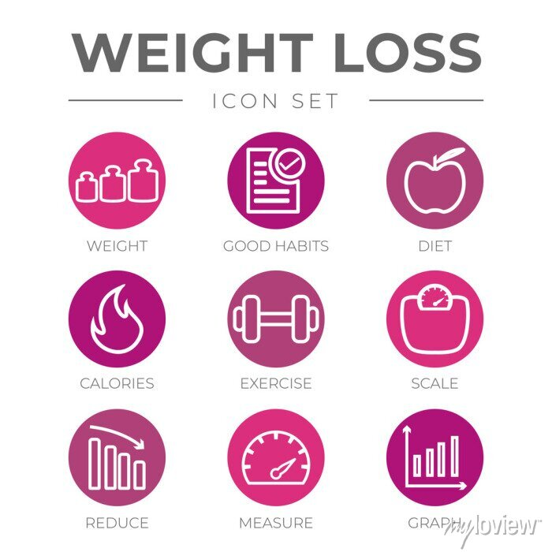
ALGORITHM & DEPLOYMENT
Gradient Boosting Algorithms(e.g., XGBoost, LightGBM, CatBoost):
Gradient boosting algorithms build a series of weak learners sequentially, where each new learner corrects errors made by the previous one.
They are known for their high predictive accuracy and are widely used in various machine learning competitions and real-world applications
Pandas :This library helps to load the data frame in a 2D array format and has multiple functions to perform analysis tasks in one go.
Numpy : Numpy arrays are very fast and can perform large computations in a very short time.
Matplotlib/Seaborn : This library is used to draw visualizations.
XGBoost – This contains the eXtreme Gradient Boosting machine learning algorithm which is one of the algorithms which helps us to achieve high accuracy on predictions.

Slide 7
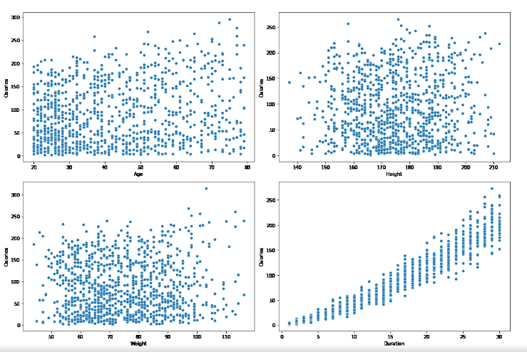
RESULT
EDA: is an approach to analyzing the data using visual techniques. It is used to discover trends, and patterns, or to check assumptions with the help of statistical summaries and graphical representations.

Slide 8

CONCLUSION
In conclusion, the development of a calories burnt prediction system using machine learning offers promising insights into enhancing fitness tracking and promoting healthy lifestyles.

Slide 9
REFERENCE
https://www.geeksforgeeks.org/calories-burnt-prediction-using-machine-learning/
https://ieeexplore.ieee.org/document/9776710
https://www.researchgate.net/publication/372104285_A_Study_on_Calories_Burnt_Prediction_Using_Machine_Learning

